Slide 1

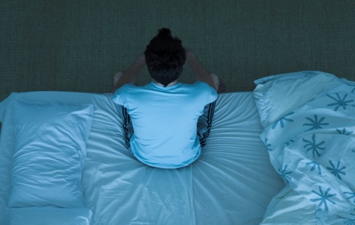
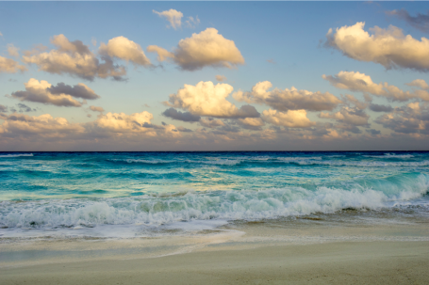
3
Unit 2 Section A
Swimming through fear
FOREIGN LANGUAGE TEACHING AND RESEARCH PRESS
AIR FORCE ENGINEERING UNIVERSITY
Notes:
1

Slide 2
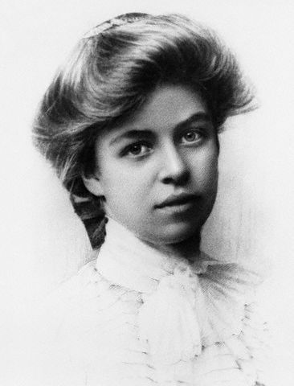
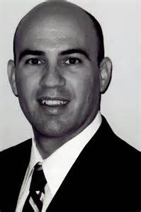
3
2
Beat your fear
UNIT
You gain strength, courage and confidence by every experience in which you really stop to look fear in the face. You are able to say to yourself, “I lived through this horror. I can take the next thing that comes along.”
— Eleanor Roosevelt
Don’t fear failure so much that you refuse to try new things. The saddest summary of a life contains three descriptions: could have, might have, and should have.
— Louis E. Boone
Notes:
2

Slide 3

^{Section A}
3
2
Beat your fear
UNIT
Swimming through fear
To talk about how to beat fear
Objectives
To further understand the text
To apply the phrases and patterns
To master the essay writing skill

Slide 4





Section A
Swimming through fear
Contents
Warming-up activities
Text study
Language application
Summary

Slide 5



Section A
Swimming through fear
Warming-up activities
Lead-in
Pre-reading activities
Cultural background

Slide 6
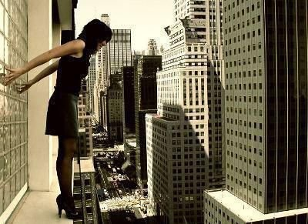
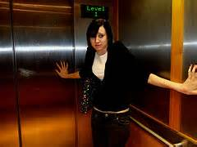
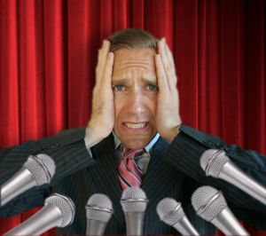
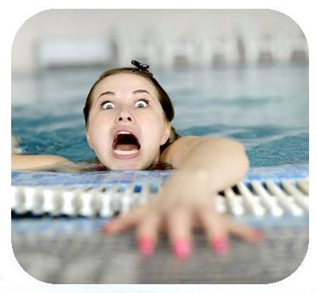
Lead-in
Short answer questions
1. Look at the following pictures, what are these people afraid of?
elevator
height
water
public speaking

Slide 7

Lead-in
Short answer questions
2. Did you have a fear of something before? If so, how did you overcome it?
Things that you might fear:
Darkness, loneliness, flying, snakes or spider, etc.
Suggestions on how to overcome fears:
1. Analyze your fear and have a clear picture of what your fear is.
2. Take control of your fear. Try to expose yourself to your fear and face it, then control it.

Slide 8
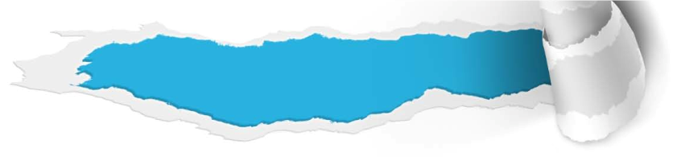

Pre-reading activities
Listen and talk
1. Listen to a story about Jack’s fear and decide whether the following statements are T (true) or F (false).
T
1. When Jack gets into bed, he thinks there’s somebody hiding under the bed.
2. As Jack lies under the bed, there must be somebody sleeping on top of it.
3. The doctor asks Jack to see him three times a week for two years to cure his fears.
4. The doctor charges Jack $200 a visit.
5. Jack is willing to pay the amount the doctor charges.
F
T
F
F

Slide 9

Pre-reading activities
Listen and talk
2. Listen to the story again and answer the following questions.
1. By whom is Jack’s problem solved? How?
Tips
2. Did you have a fear of something before? If so, how did you overcome it?
Tips

Slide 10

Pre-reading activities
Listen and talk
1. By whom is Jack’s problem solved? How?
Jack’s problem is solved by a carpenter. He told Jack to cut the legs off the bed. And then Jack was certain that nobody was sleeping under it when he got into bed.

Slide 11
Pre-reading activities
Listen and talk
2. Did you have a fear of something before? If so, how did you overcome it?
The answer is open-ended. For example, you might have the fear of darkness, the fear of heights, the fear of snakes or spiders, the fear of flying, etc. Some suggestions on how to overcome fears are listed below for reference. First, you analyzed your fear and had a clear picture of what your fear was. Then you took control of your fear. You decided to expose yourself to that fear in small doses until you gained a better understanding of it.
To be continued

Slide 12
Pre-reading activities
Listen and talk
2. Did you have a fear of something before? If so, how did you overcome it?
As a result, your fear began to disappear. Finally, you successfully changed the way you thought about your fear. You started seeing fear as a source of energy and embraced its role in your life.

Slide 13

Pre-reading activities
Compound dictation
Listen to a short passage concerning fear and fill in the missing information.
This is the VOA Special English Health Report.
A panic attack is a sudden feeling of _______. Usually it does not last long, but it may feel like forever. The cause can be something as _________ uneventful as driving over a bridge or flying in an airplane.
terror
normally
To be continued

Slide 14
Pre-reading activities
Compound dictation
Listen to a short passage concerning fear and fill in the missing information.
And it can happen even if the person has driven over many bridges or flown many times before. A fast heartbeat. Sweaty hands. _________ breathing. A lightheaded feeling. At first a person may have no idea what is wrong. But these can all be ______ of what is known as panic disorder.
Difficulty
signs
To be continued

Slide 15
Pre-reading activities
Compound dictation
Listen to a short passage concerning fear and fill in the missing information.
The first __________ usually is between the ages of eighteen and twenty-four. In some cases it develops after a tragedy, like the death of a loved one, or some other difficult __________. Some people who suffer a panic attack develop a phobia, a deep fear of ever repeating the activity that __________ the attack.
appearance
situation
brought on
To be continued

Slide 16
Pre-reading activities
Compound dictation
Listen to a short passage concerning fear and fill in the missing information.
But experts say panic disorder can be ________. Doctors might suggest anti-anxiety or antidepressant medicines. Talking to a counselor could help a person learn to __________ or avoid a panic attack. There are breathing methods, for example, that might help a person __________.
treated
deal with
calm down

Slide 17
Cultural background
The Mediterranean Sea
Questions Previewing
1. Have you ever heard about Mediterranean Sea? What do you know about it?
Tips
2. Do you know what is “rip current”? How to escape from rip current?
Tips

Slide 18
Cultural background
The Mediterranean Sea
Have you ever heard about Mediterranean Sea? What do you know about it?
• an intercontinental sea;
• stretches from the Atlantic Ocean;
• surrounded by the Mediterranean region;
• enclosed by land: on the north by Europe, on the south by Africa, and on the east by Asia;
• pleasant climate, beautiful coastline, rich history and diverse culture.

Slide 19
Cultural background
The Mediterranean Sea
2. Do you know what is “rip current”? How to escape from it?
Rip Current:
a narrow, powerful current of water running perpendicular to the beach, out into the ocean
How to escape from rip current:
• swim sideways, parallel to the beach;
• get you out of the narrow outward current;
• wait until the current carries you past the sandbar.

Slide 20


Section A
Swimming through fear
Text study
Main idea & structure
Language focus
Critical thinking

Slide 21

Main idea & structure
Main ideas of the parts
What was the beach of Mediterranean Sea known for? (Para. 1)
Tips
notorious rip currents
How did the author feel when he saw the sea? (Para. 2)
Tips
sick to his stomach

Slide 22

Main idea & structure
Main ideas of the parts
Para. 3
good
I’d always ______ water and been a _______ swimmer until last summer, when I’d decided to climb up to ________________________ at the pool. I’d _________ from that height and hit the water with an ________________. The air was ________ from my lungs and I ____________. The next thing I knew, my brother was pulling my ________ body out of the pool. From then on, my _____ wouldn’t ________; I was absolutely ______________.
loved
the highest diving board
hopped
incredible impact
ousted
blacked out
feeble
fear
recede
terrified of water
Notes:
22

Slide 23
Main idea & structure
Main ideas of the parts
Part I — (Paras. 1- __)
3
On a tour of France, I saw the Mediterranean Sea, but the rip currents __________ me. And it reminded me that I developed ______________ due to the experience of last summer and since then, the fear wouldn’t _________.
scared
a fear of water
recede

Slide 24

Main idea & structure
Main ideas of the parts
Why were a mob of people running into the sea, fully clothed? (Para. 6-7)
Tips
A boy was moving up and down amid the waves, past the end of the jetty.
Notes:
24

Slide 25
Main idea & structure
Main ideas of the parts
What did the would-be rescuers do to save the boy? What about the author? (Paras. 7-9)
saving measures
would-be rescuers | author
They fought against the tide, but the situation was bleak. With the water’s tow, they’d never get to him in time.
I appraised the situation and realized — the jetty! The boy was close to it; maybe I could help from there.

Slide 26
Main idea & structure
Main ideas of the parts
What were the results of their saving measures?
(Para. 10)
results of saving measures
would-be rescuers | author
I was the only one who saw that going out on the jetty was the fastest way to reach the drowning boy.
They had underestimated the waves and weren’t making any progress.

Slide 27

Main idea & structure
Main ideas of the parts
Why did the author become hesitant when he raced down the beach, out onto the jetty? (Para. 9)
Tips
I raced down the beach, out onto the jetty, and it hit me: Water! My palms got sweaty and my stomach felt sick, symptoms of my fear. I stopped short.

Slide 28
Main idea & structure
Main ideas of the parts
How did the author feel when he stopped short?
(Para. 11)
Tips
I was _________________, but I ________________ move forward with this __________________.
paralyzed with fear
forced myself to
impromptu rescue
Notes:
28

Slide 29
Main idea & structure
Main ideas of the parts
Para. 12
At the ridge of the jetty, I _________ around, ___________ I’d see an athletic swimmer _______________ the rough water toward the boy. ____________, no one was there. I turned back out to the sea to see the boy _______________________ about 25 yards away from me. ____________ a deep breath, I ________________________. As soon as I jumped in, I felt like I was back in that pool, __________, __________, __________.
whirled
convinced
plowing through
To my dismay
battered by vicious waves
Sucking in
threw myself into the water
terrified
breathless
struggling
Notes:
29

Slide 30

Main idea & structure
Main ideas of the parts
How did the boy respond when the author grabbed him? (Para. 13)
Tips
The boy popped back up, eyes wide with terror, pawing and twisting against him.
Notes:
30

Slide 31
Main idea & structure
Main ideas of the parts
What happened when they turned back toward shore? (Para. 14)
Tips
A wave pounded over them and the rip current dragged them out to the sea.
Notes:
31

Slide 32
Main idea & structure
Main ideas of the parts
How did the author and the boy make their way to safety? (Para. 15)
Tips
Do as the saving class taught them: Swim sideways and float to rest.
Notes:
32

Slide 33
Main idea & structure
Main ideas of the parts
What kind of incredible things the author realized when they were safe? (Para. 16)
Tips
I was no longer afraid. That absence of fear was a moment of triumph!
Notes:
33

Slide 34
Main idea & structure
Main ideas of the parts
Part II — Paras. 4-17
When I saw a boy drowning amid the waves, I was in a _______ and __________ struggle whether I should save him because I was extremely ___________ water. After my fierce struggle, I made the single big decision: to ________________ the water. I finally reached the boy and had him under control; but when I swam back toward shore, the rip current was ________________ us out to sea. I tried to remember how to escape from a rip current, and with that, I slowly ____________ to safety, thus __________ my inner fear of water as well.
mental
emotional
terrified of
threw myself into
forcibly dragging
made my way
conquering

Slide 35
Main idea & structure
Main ideas of the parts
Why did the author feel the water had never looked so beautiful when he reached the jetty? (Para. 18)
Tips
The author had already conquered his inner fear of water and he also felt relieved and delighted when he saw the boy was hugged tightly by his mother.
Notes:
35

Slide 36
Main idea & structure
Main ideas of the parts
Part III — (Paras. 18-19)
I was _______ and ______ in a moment of _______ and ________.
relaxed
happy
triumph
salvation

Slide 37
Main idea & structure
Structure of the text
Introduction: Exposition of the plot
On a tour of France, I saw the Mediterranean Sea, but the rip currents scared me. (Paras. 1-2)
Flashback: I developed a fear of water due to the experience of last summer and since then, the fear was deeply
rooted in me. (Para. 3)

Slide 38
Main idea & structure
Structure of the text
Exposition
Development
Rising action of the plot.
(Paras. 4-10)
Climax or turning point of the plot.
(Paras. 11-12)
Falling action of the plot.
(Paras. 13-14)
Resolution of the plot.
(Paras. 15-17)

Slide 39
Main idea & structure
Structure of the text
Exposition
Development
Conclusion

Slide 40
Main idea & structure
Summary of the text
Swimming through fear
On a tour of France, I saw the Mediterranean Sea, but the rip currents __________ me. And it reminded me that I developed ______________ due to the experience of last summer and since then, the fear wouldn’t _________.
scared
a fear of water
recede
To be continued

Slide 41
Main idea & structure
Summary of the text
When I saw a boy drowning amid the waves, I was in a _______ and __________ struggle whether I should save him because I was extremely _________ water. After my fierce struggle, I made the single big decision: to _______________ the water. I finally reached the boy and had him under control; but when I swam back toward shore, the rip current was ________________ us out to sea.
mental
emotional
terrified of
threw myself into
forcibly dragging
To be continued

Slide 42
Main idea & structure
Summary of the text
I tried to remember how to escape from a rip current, and with that, I slowly ____________ to safety, thus __________ my inner fear of water as well. I was _______ and ______ in a moment of _______ and _________.
made my way
conquering
relaxed
happy
triumph
salvation

Slide 43
Language focus
Practical phrases
Practical Phrases | Meanings
1 deem sth. important | 认为……重要
2 pop up | 突然出现；冒出来
3 be paralyzed with | 使丧失思考能力，使呆若木鸡
4 plow through sth. | 艰难费力的通过
5 throw oneself into / at / on / down | 突然猛力地冲进/扑向/跳到/扑倒等
6 make one’s way | 行进（尤指艰难地，或需要很长时间时）

Slide 44

Language focus
Practical phrases
认为……重要
短语逆译
deem sth.important
短语应用
别人认为重要的，并不能作为你确定目标的根据。只有你自己才知道，什么东西对你最重要。
意群提示
(set your goals/ deem)
Don’t set your goals by what other people deem important. Only you know what is important to you.

Slide 45
Language focus
Practical phrases
突然出现；冒出来
短语逆译
pop up
短语应用
这几年中国的亿万富豪频繁出现在《福布斯》杂志排行榜上。
意群提示
(billionaires / pop up/ Forbes magazine)
For years, Chinese billionaires began to pop up most frequently in Forbes magazine.

Slide 46
Language focus
Practical phrases
使丧失思考能力；使呆若木鸡
短语逆译
be paralyzed with
短语应用
大多数人都害怕公共演说。一想到要独自站在一大群听众面前讲话就会吓得不知所措。
意群提示
(public speaking/ be paralyzed with)
Most people fear public speaking. They are always paralyzed with the thought of standing alone in front of and speaking to a large audience.

Slide 47
Language focus
Practical phrases
艰难费力的通过
短语逆译
plow through sth.
短语应用
为了收集论文资料，我只好啃了几十本经济学的旧书。
意群提示
(gather material /plow through)
In order to gather material for my thesis, I had to plow through dozens of old books on economics.

Slide 48
Language focus
Practical phrases
突然猛力地冲进/
扑向/跳到/扑倒等
throw oneself into / at / on / down
短语逆译
短语应用
小男孩一见到自己的母亲，马上扑进了她的怀抱。
意群提示
(threw oneself into sb’s arms)
Seeing his mother, the boy threw himself into her arms.

Slide 49
Language focus
Practical phrases
行进（尤指艰难地，或需要很长时间时）
短语逆译
make one’s way
短语应用
他没有努力上进的决心。
意群提示
(determination/ make one’s way)
He doesn’t have the determination to make his way in the world.

Slide 50
Language focus
Functional patterns
Functional Patterns | Functions & Usages
1. Nothing … as much as … | 否定比较级，用于表达“最……”。
2. As sb. did sth., sb. realize something incredible / provoking / important: sb. no longer … | 用于表达“某人对某些事的反思”。
3. Adj. as sb. was, sb. / sth. had never looked adj. | 用于表达“某人对某事或某人新的看法”。
Notes:
50

Slide 51
Language focus
Functional patterns
原句译文
没有什么比水让我更害怕了。
逆译练习
Nothing scared me as much as water. (Para. 1, L1)
句型提炼
Notes:
51

Slide 52

Language focus
Functional patterns
句型提炼
Nothing … as much as …
应用提示
否定比较级，用于表达“最……”。
句型应用
Notes:
52

Slide 53
Language focus
Functional patterns
典型例句
世界上最让人困扰的就是自己的心境。
意群提示
( bother /mind)
Nothing in the world can bother you as much as your own mind.

Slide 54
Language focus
Functional patterns
原句译文
后来我们到达安全水域时，我觉得有些不可思议：我不再怕水了。
逆译练习
And, as we made our way to safety I realized something incredible: I was no longer afraid. (Para. 16, L1)
句型提炼
Notes:
54

Slide 55
Language focus
Functional patterns
句型提炼
As sb. did sth., sb. realize something incredible/ thought-provoking/ important: sb. no longer …
应用提示
用于表达“某人对某些事的反思”。
句型应用
Notes:
55

Slide 56
Language focus
Functional patterns
典型例句
当我们对智能技术上瘾后，令人深思的是：面对面交流已不复存在，朋友之间已成陌路。
意群提示
(get addicted to/ smart technologies)
As we get addicted to the smart technologies, we realized something thought-provoking: we no longer have the face-to-face communication and become strangers to our friends.

Slide 57
Language focus
Functional patterns
原句译文
虽已疲惫不堪，但放眼大海，我感觉海水比任何时候看起来都更美。
逆译练习
I looked out to the sea. Weary as I was, the water had never looked so beautiful. (Para. 19, L4)
句型提炼
Notes:
57

Slide 58
Language focus
Functional patterns
句型提炼
adj. as sb. was, sb./sth. had never looked so adj. …
应用提示
用于表达“某人对某事或某人新的看法”。
句型应用
Notes:
58

Slide 59
Language focus
Functional patterns
典型例句
虽然她长相平平，但现在她比以往任何时候看起来都要更优雅、更美丽。
意群提示
(plain-looking)
Plain-looking as she was, she had never looked so graceful and beautiful.

Slide 60


Language focus
Language appreciation
我瞥见防波堤尽头的海浪中有个东西在上下浮动。我惊恐地意识到大事不妙，倒吸了一口凉气，那居然是个小男孩！
a. I glimpsed something moving up and down amid the waves, past the end of the jetty. I gasped, realizing the catastrophe with horror. That’s a little boy out there! (Para. 7, L1)

Slide 61
Language focus
Language appreciation
一跳进水里，我感觉仿佛又回到了当年的那个游泳池，我喘不过气，拼命挣扎，惊恐万分。
b. As soon as I jumped in, I felt like I was back in that pool, breathless, struggling, terrified. (Para. 12, L4)

Slide 62
Language focus
Language appreciation
我全身都快虚脱了，我不再划水，就这样放松自己顺水而漂。我的手碰上了防波堤，仿佛触电一般，我重新恢复了神志。
c. On the brink of collapse, I stopped fighting, just letting myself go. My hand hit the jetty. It was like an electric shock that brought me back to my senses. (Para. 18, L1)

Slide 63
Language focus
Language appreciation
我感觉到强壮有力的手臂将我托起。我不仅从海里爬上防波堤的磐石，而且完成了自我拯救，摆脱了困扰已久的恐惧。
d. I felt strong arms lift me. I ascended not only from the sea onto the secure rocks of the jetty — but also to my salvation, leaving behind the terrible fear that had gripped me for so long. (Para. 19, L1)

Slide 64

Critical thinking
Theme exploration
Why do people have inner fear of something such as spiders, snakes, water, heights, flying in airplanes, death, etc.?
Tips
What are your suggestions to a young man who gives up at the last minute when he is going to ask a girl on a date?
Tips
Does psychological fear produce any positive aspects in people’s life? If yes, what are they?
Tips

Slide 65

Critical thinking
Theme exploration
Why do people have inner fear of something such as spiders, snakes, water, heights, flying in airplanes, death, etc.?
The fears may come from:
• our own past experience;
• other people’s fears we witness;
• someone’s description about their fears;
• influence of specific cultural and historical context.

Slide 66
Critical thinking
Theme exploration
2. What are your suggestions to a young man who gives up at the last minute when he is going to ask a girl on a date?
To get a guy to ask a girl out, try giving him some pointers and ideas on how to approach the situation with confidence:
• Tell the guy to ask a girl on a casual date and see where it goes from there.
• Encourage the guy to be assertive and not beat around the bush.
• Suggest that the guy give the girl some choices as to where to go on a date.

Slide 67
Critical thinking
Theme exploration
3. Does psychological fear produce any positive aspects in people’s life? If yes, what are they?
Obsessive fear leads to anxiety, panic attacks and a variety of psychological problems. We all know what it’s like to feel overwhelmed by fear, but fear, as it turns out, is a fundamental part of our lives, and has some positive effects on our lives:
• Fear prepares us to protect ourselves from anything potentially threatening or harmful..
• Fear is an invitation to act.
• Fear pushes us beyond our limits.
• Fear is necessary in developing our courage.

Slide 68
Critical thinking
Culture exploration
According to recent survey in America, what the college students fear most in the future is: postgraduate study or job-hunting. It is also true to Chinese students. Which one is more important? Please list your reasons.
For those who are eager to become economically independent and to put into practice what they have learned in college, taking a job will be both satisfying and rewarding. Moreover, at many times during their study they must have been embarrassed by the lack of money or by the guilty feeling from spending their parents’ money or “luxuries”. Getting established as a bread-earner after graduation is what they have been desiring.
to be continued

Slide 69
Critical thinking
Culture exploration
According to recent survey in America, what the college students fear most in the future is: postgraduate study or job-hunting. It is also true to Chinese students. Which one is more important? Please list your reasons.
Those who want to take advantage of the favorable conditions in college, however, will in all likelihood, try to enroll in graduate programs. For them, a master’s degree or even a doctoral degree represents a much more ambitious goal of learning than a bachelor’s degree. In the same way, their lifetime success and interest lie more in making academic achievements than in making money.

Slide 70



Critical thinking
Watch a video clip and discuss the question:
How many steps the speaker mentioned to overcome any fear? And what are they?
Tips
Video Watching

Slide 71
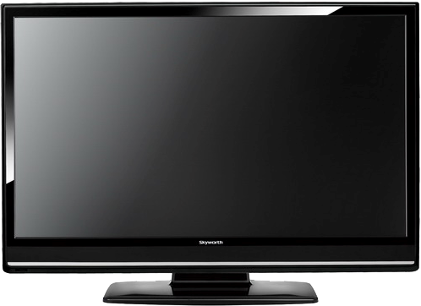

Critical thinking
Back

Slide 72

Critical thinking
How many steps the speaker mentioned to overcome any fear? And what are they?
7steps. They are:
Step 1, write down exactly what you are afraid of and why.
Step 2, pick an encouraging mantra like “I can handle this”, or “Nothing can harm me”, and repeat it in your head whenever you have to do something that scares you.
to be continued

Slide 73
Critical thinking
How many steps the speaker mentioned to overcome any fear? And what are they?
Step 3, the next time you have to do something that is scaring, make a fist, hold for 10 seconds, then release.
Step 4, eat more turkey, cheese, and nuts, they all contain tryptophan and monoamine oxidase that helps people feel less anxious.
to be continued

Slide 74
Critical thinking
How many steps the speaker mentioned to overcome any fear? And what are they?
Step 5, use soothing essential oils, available in health food stores.
Step 6, face your fear, again and again and again.
Step 7, ask your doctor about medications that have shown promise in reducing fear when a person is faced with a scaring situation.

Slide 75

Section A
Swimming through fear
Language application
Writing devices
Oral reproduction
Paragraph translation

Slide 76
Writing devices
Writing devices
Essay writing
Essay writing
Develop a narrative essay
The plot is how the author arranges events to develop his basic idea. It is a planned, logical series of events with a beginning, middle, and end. There are usually five essential parts of a plot: exposition, rising action, climax (or turning point), falling action, and resolution.

Slide 77

Writing devices
Essay writing
Let’s look at Text A to see how the author plots a story:

Slide 78
Writing devices
Essay writing
Resolution
The author defeated the water and the boy was rescued. (Paras. 15-17)
Falling Action
The author tried to save the boy, but the rip current seemed to triumph. (Paras. 13-14)
Climax
After intense mental struggle, the author was determined to save the boy. (Paras. 11-12)
Rising Action
A conflict occurred: the author’s fear of water and a boy drowning in the water. (Paras. 4-10)
Exposition
The author came to the Mediterranean Sea and it reminded him of his terror of water. (Paras. 1-3)

Slide 79
Writing devices
Essay writing
Read the sample essay and see how it develops with five essential parts of a plot.

Slide 80
Writing devices
Essay writing
Topic:
Dad’s blessings
Introduction:
Thesis statement: We often misread people we truly care for in our life and may never again have a chance to make up for it.
Exposition:
Setting: Upon graduation, a young man was expecting his dad’s blessing.
to be continued

Slide 81
Writing devices
Essay writing
Conflict: The father’s gift, a Bible with the young man’s name on it in gold, resulted in the young man’s storming out of the house on Graduation Day.
Development:
Rising action: Having become successful, the young man decided to pay a visit to his father.
Climax: When the young man made arrangements to visit his father, he was informed of his father’s death.
to be continued

Slide 82
Writing devices
Essay writing
Falling action: When he arrived at his father’s house, sudden sadness and regret filled his heart.
Conclusion:
Resolution: The young man found the key for the sports car he once dreamed of in the still new Bible when searching through his father’s belongings. But his father was gone.
to be continued

Slide 83
Writing devices
Essay writing
Sample:
A young man was getting ready to graduate from college. For many months he had admired a beautiful sports car in a dealer’s showroom, and knowing his father could well afford it, he told him that was all he wanted.
As Graduation Day approached, the young man awaited signs that his father had purchased the car. Finally, on the morning of his graduation, his father called him into his private study.
to be continued

Slide 84
Writing devices
Essay writing
His father told him how proud he was to have such a fine son, and told him how much he loved him. He handed his son a beautifully wrapped gift box. Curious, but somewhat disappointed, the young man opened the box and found a lovely, leather bound Bible, with the young man’s name on it in gold. Angrily, he raised his voice and said to his father, “With all your money, you give me a Bible?” and stormed out of the house, leaving the Bible behind.
to be continued

Slide 85
Writing devices
Essay writing
Many years passed and the young man was very successful in business. He had a beautiful home and wonderful family. Realizing his father was very old, he thought perhaps he should go to him. He had not seen him since that Graduation Day. Before he could make arrangements, he received a telegram telling him his father had passed away, and willed all of his possessions to him. He needed to come home immediately and take care of things.
to be continued

Slide 86
Writing devices
Essay writing
When he arrived at his father’s house, sudden sadness and regret filled his heart. He began to search through his father’s important papers and saw the still new Bible, just as he had left it years ago. With tears, he opened the Bible and began to turn the pages. And as he did, a car key dropped from the back of the Bible. It had a tag with the dealer’s name, the same dealer who had the sports car he had desired. On the tag was the date of his graduation, and the words “PAID IN FULL”.

Slide 87
Writing devices
Essay writing
Writing practice
Directions: Write an essay of no less than 150 words on one of the following topics. One topic has an outline you can follow.

Slide 88
Writing devices
Essay writing
Topic: Slow down
Introduction: Thesis statement: We shouldn’t go through life so fast that we have little time to care for other people.
Exposition:
Setting: A young and successful executive was traveling down a neighborhood street, going a bit too fast in his new Jaguar (捷豹).
Conflict: A brick smashed into the car’s side door, and the angry executive grabbed a kid for smashing his car.
Development:
Rising action: The boy explained that he just needed his help because his brother fell out of the wheelchair, and he couldn’t lift him up by himself.
to be continued

Slide 89
Writing devices
Essay writing
Climax: Moved beyond words, the driver tried to swallow the rapidly swelling lump in his throat.
Falling action: The young man hurriedly helped lift the handicapped boy back into the wheelchair, then took out his fancy handkerchief and gently cleaned the boy’s fresh scrapes and cuts.
Conclusion:
Resolution: The driver never bothered to repair the damaged side door and used it as a reminder of what he had learned from this experience.

Slide 90
Writing devices
Essay writing
More topics:
• My biggest mistake
• An embarrassing experience

Slide 91
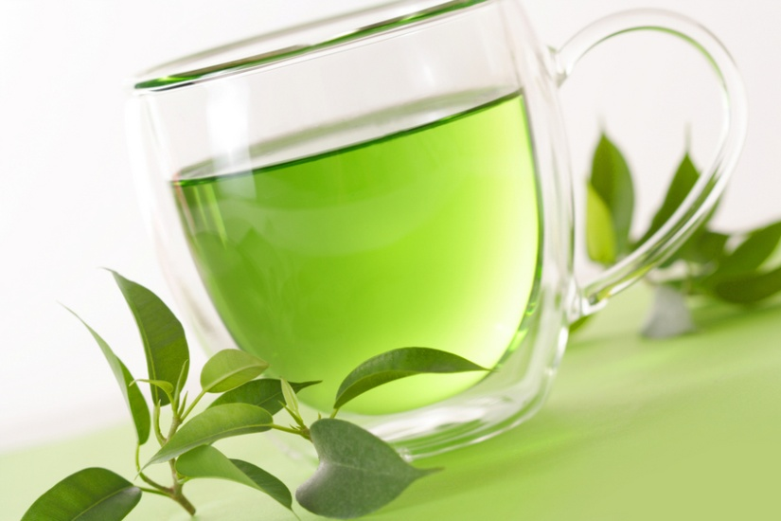
Oral reproduction
Speech making
Make a speech on the following topic.
Suppose, as an eye-witness, you are expected to write a report to the police.

Slide 92
Oral reproduction
Speech making
You can follow the outline given below.
Part I. Exposition:
You may include the following points:
1. Main character (type of cars).
2. Time (exact time of the accident).
3. Place (exact place of the accident).
4. Your position.
To be continued

Slide 93
Oral reproduction
Speech making
You can follow the outline given below.
Part II. Rising action:
The description of two (or more) cars before the accident.
Part III. Climax:
How the cars were crashed.
Part IV. Falling action:
The description of the car damage.
Part V. Resolution:
How did the police deal with the accident? And what about the people in the car?
To be continued

Slide 94
Oral reproduction
Speech making
You may adopt the following expressions.
black out;
a mob of people;
stop short;
be paralyzed with;
plow through sth.;
throw oneself into/ at/ on/ down;
make one’s way;
pop up;
in the midst of;
to one’s dismay

Slide 95

Paragraph translation
Translate a paragraph based on a summary of the text by using the expressions from the text.

Slide 96
Paragraph translation
在一次法国旅行当中，我见到了地中海，但是其可怕的裂流让我不寒而栗。这让我想起了去年夏天的那场经历，使得我对水极为恐惧，从那时起，这个恐惧就没有消退过。当我看到一个男孩淹没在海浪中，我就处在了是否应该救他的思想和情感斗争之中，因为，我怕极了水。
shiver
recede
mental and
emotional struggle
I was extremely terrified of water
To be continued

Slide 97
Paragraph translation
经过激烈的斗争后，我做了一个很大的决定：纵身跃入水中。我最终赶到了男孩的身边，并且控制住了他，但是当我朝岸边游去的时候，裂流强行把我们拽往大海深处。我试着回忆起如何从裂流中逃生，按照这个方法，我慢慢地达到安全水域，同时也战胜了内心对水的恐惧。在胜利和自我拯救的那个时刻，我感到很放松、很高兴。
threw myself into the water
forcibly dragging us out to the sea
made my way to safety
conquer my inner fear of water
Samples

Slide 98
Paragraph translation
On a tour of France, I saw the Mediterranean Sea, but the terrible rip currents shivered me. And it reminded me that I developed a fear of water due to the experience of last summer and since then, the fear wouldn’t recede. When I saw a boy drowning amid the waves, I was in a mental and emotional struggle whether I should save him because I was extremely terrified of water.
To be continued

Slide 99
Paragraph translation
After my fierce struggle, I made the single big decision: to throw myself into the water. I finally reached the boy and had him under control; but when I swam back toward shore, the rip current was forcibly dragging us out to sea. I tried to remember how to escape from a rip current, and with that, I slowly made my way to safety, thus conquering my inner fear of water as well. I was relaxed and happy in a moment of triumph and salvation.

Slide 100

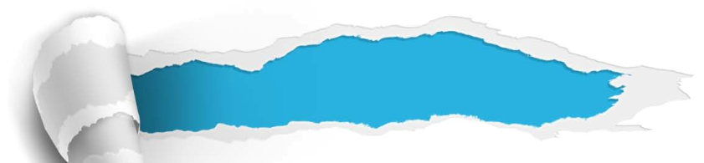
Section A
Swimming through fear
Summary
Revision of
the useful expressions
Thematic study
Revision of
the functional patterns

Slide 101
Revision of
the useful expressions
Language points—Useful expressions
1 对水的恐惧从未消退过
2 情况不容乐观
3 没有任何进展
4 在性命攸关之际
5 突然出现
6 因恐惧而全身瘫软
7 艰难地通过
fear of water never recede
the situation is bleak
do not make any progress
in the midst of the tragedy
pop up
be paralyzed with fear
plow through

Slide 102
Revision of
the useful expressions
Language points—Useful expressions
8 令人沮丧的是
9 深吸一口气
10 纵身跃入水中
11 看上去很荒谬但却很管用
12 行进
13 摆脱
14 困扰已久
to one’s dismay
suck in a deep breath
throw oneself into the water
odd-looking but practicable solution
make one’s way
leave behind
grip for so long

Slide 103
Revision of
the functional patterns
Language points—Useful patterns
Functions & Usages | Sentence Patterns
1. 否定的比较级，用于表达 “最……”。
2. 用于表达“某人对某些事的反思”。
3. 用于表达“某人对某事或某人新的看法”。
nothing … as much as …
as sb. did sth., sb. realize sth. incredible / provoking / important: sb. no longer …
adj. as sb. was, sb. / sth. had never looked adj.
Notes:
上面挤，下面空

Slide 104


Section A
Swimming through fear
The end

